Slide 1

Contemporary World
Lecture No.1

Slide 2
Introduction to C.W
Why should business/Commerce Students study Contemporary World
Importance of Contemporary World for Pakistani Managers
Political and Economic world Geography
Globalization
Developed World
Developing, Under developed World

Slide 3
Why should business/Commerce Students study Contemporary World
Yes/NO Debate
What are current Issues
Discussion

Slide 4


Nestle owned supplier of baby foods first started selling their baby food in Africa, they used the same packaging as in the USA – with the cute baby on the label. Later they found out that in Africa, companies routinely put pictures on the label of what is inside the package, since most people cannot read.

Slide 5
Economic Geography: the subject matter of the discipline
The words “economic” and “geography” have their roots in the Greek language:
“Economic” comes from the Greek word oikos, meaning “home”.
The implication here is that economic matters are matters of tending to the requirements of one’s household – of taking care of oneself and one’s family.
Note the implication here that one is concerned with something local.
“Geographic” comes from the Greek word geos meaning “earth”.
The implication here is that geographic matters deal with land and terrestrial space.
Note the implication here that one is concerned with something of decidedly broader scope than the local – the regional, national or global.

Slide 6
Theorizing in Economic Geography: The Factors of Production
Economics concerns itself with production, which is the provision of items for people either to consume (consumption) or to keep as valuable property (wealth).
There are three “factors” of production, which account for all possible forms of productive economic activity:
Land / Natural Resources – any commodity which is provided by the earth (e.g., a forest/the wood found there)
Labour – the work one does, taken as a commodity (e.g., lumberjacking)
Capital – any commodity which may be in turn used in further production (e.g., a paper factory)
Economic geography is concerned with the tracking of production in geographic space.

Slide 7
Introduction to Political Geography
Political geography helps explain the cultural and physical factors that underlie political unrest.
Political geographers study how people have organized Earth’s land surface into countries and alliances, the reasons for doing so, and the conflicts that can erupt from the organization.

Slide 8
Where are States Located?
Almost all land on the Earth belongs to a country
Not true as recently as 1940s – only about 50 countries then
Now there are 193 members of the UN
State- an area organized into a political unit and ruled by an established government. that has control over its internal and foreign affairs
Occupies a defined territory and has a permanent population

Slide 9
continued
Sovereignty- independence from control of its internal affairs by other states
States are examples of formal regions because the entire territory is ruled by a common gov., laws, military etc.
Country and state are synonyms

Slide 10
Problems of Defining States
Antarctica is the only large landmass on Earth that is not part of any state
Argentina, Australia, Chile, France, New Zealand, Norway, and the UK all claim portions of Antarctica
The US and Russia do not recognize these claims
The Treaty of Antarctica 1959 (1991) says states may establish research stations but may not have a military presence

Slide 11
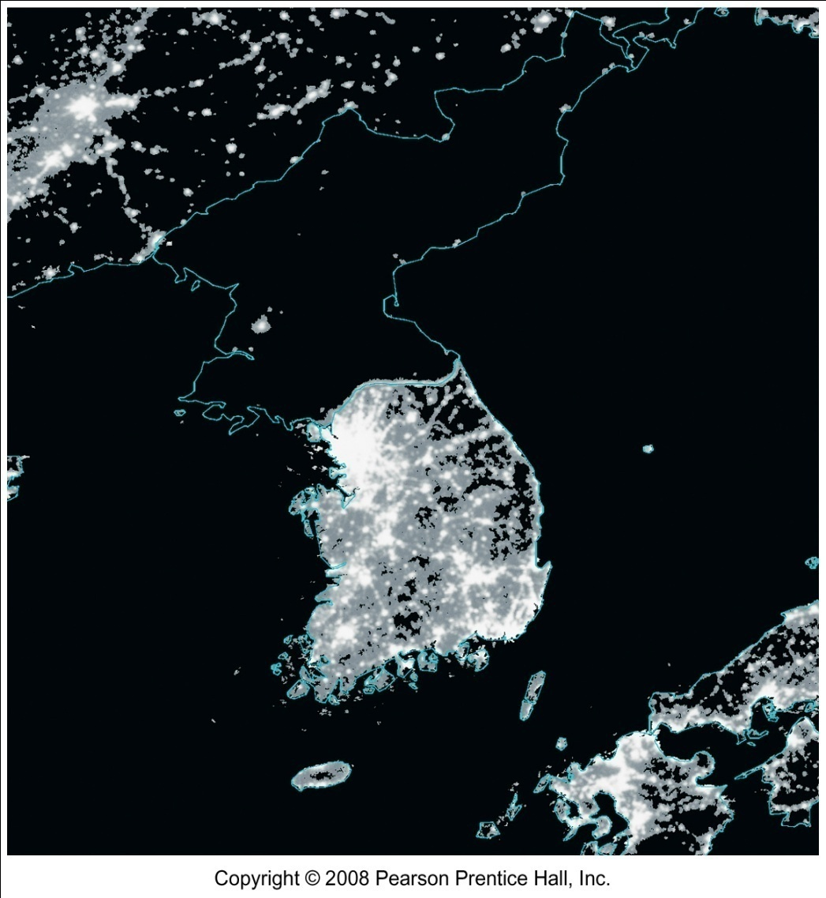
Korea: One State or Two?
After Japan was defeated in WWII, Korea was divided into two occupation zones by the US and Russia
Division was made at 38 degrees N. Latitude
N. Korea invaded South Korea in 1950
After 3 years, a cease-fire was agreed upon near the 38th parallel

Slide 12
continued
Both gov. are committed to reunification
In 2000 they agreed to exchange visits of families separated for more than 50 years and for increased economic cooperation
Progress slowed by N. Korea’s decision to build nuclear weapons even though the country can’t provide its citizens with food, electricity, etc.
Both countries were admitted into the UN in 1992

Slide 13
China and Taiwan: One State or Two?
In 1949 the ruling gov. of China lost a civil war and fled to the island of Taiwan
They claimed to still be the rightful gov. of China and that they were waiting for the defeat of the communists so they could return to the mainland
Communist China claimed Taiwan and vice versa
They agreed there was only 1 states, but not about who ruled it

Slide 14
Globalization
An international system
Replaced Cold War system (’89)
Free-market capitalism
“Americanization” - ??

Slide 16
Definition of Globalization
Disagreement over definition
Can be framed in a variety of ways
Definition for this purpose
“A process leading to greater economic interdependence and networks and the economic, political, social, cultural, and environmental results of that process.”

Slide 17
Positive Effect of Globalization on Equality
Income increased globally
Increased wages for well educated
Increased wages for technologically skilled
Improved economic conditions for those who compete successfully in the global economy
Increased access to more goods
Reduced prices duet to competition

Slide 18
Negative Effect of Globalization on Equality
Greater gap between the haves and the have-nots
Some downward pressure on wages for the poorly educated and technologically unskilled
Worsened economic conditions in countries marginalized from the global economy.

Slide 19
Positive Effect of Globalization on Labor Conditions
Increased job opportunities
Upgraded education system and more training
Increased labor standards
Increased labor productivity

Slide 20
Negative Effect of Globalization on Labor Conditions
Certain industries were forced out of business
Decreased labor conditions, forced over time, etc
Decreased power of unions, benefits, and pensions

Slide 21
Globalization and Culture
Greater cross-cultured understanding
Double edged sword
Monoculture
Other views of decentralization
Regional centers
Ethical identity

Slide 22
Globalization and Governments
Historically, governments played a major role in the promotion of economic development
Currently, governments have less to do with the economic development within their borders

Slide 23
Technology, Governments, and Globalization
Technology has allowed businesses to move and change so fast that governments can’t keep up
Technology has also helped break down the market boundaries, making it a losing battle for governments to try to control them

Slide 24

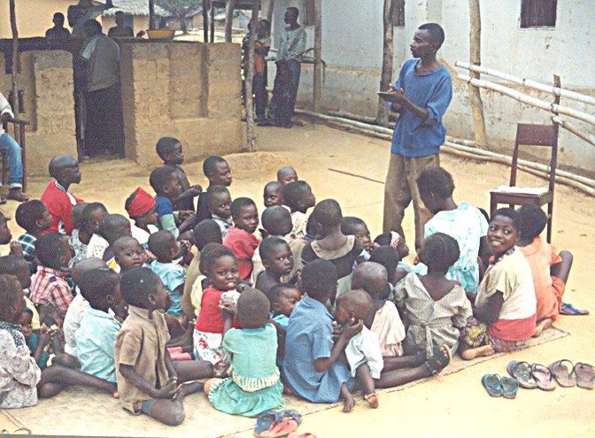
Developed vs. Developing
Developed
Developing
Good educational system; school required
Schooling not available to all citizens of country.

Slide 25
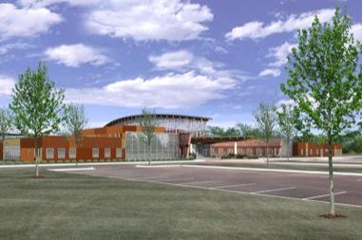
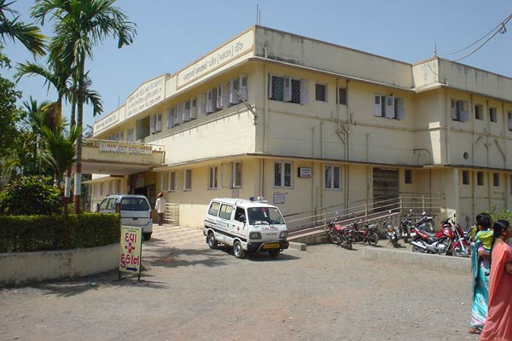
Developed vs. Developing
Developed
Developing
Widely available health care.
Poor health care; not enough doctors.

Slide 26
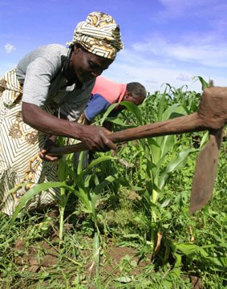
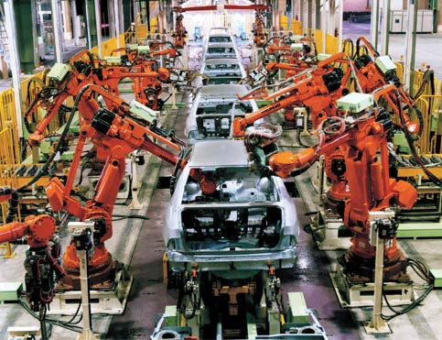
Developed vs. Developing
Developed
Developing
Many manufacturing and service industries. Farmers use technology.
Live by subsistence farming in rural areas. Few businesses.

Slide 27


Developed vs. Developing
Developed
Developing
Participate in international trade
Few items to trade

Slide 28
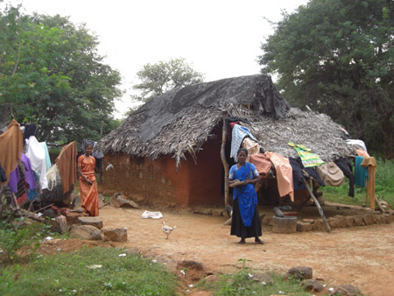
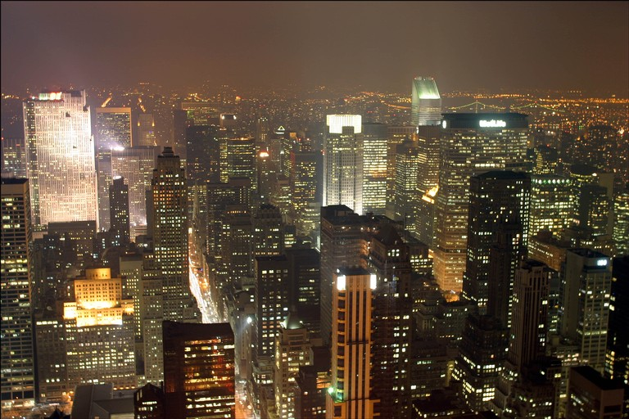
Developed vs. Developing
Developed
Developing
People mostly live in cities.
People live mostly in rural areas.

Slide 29
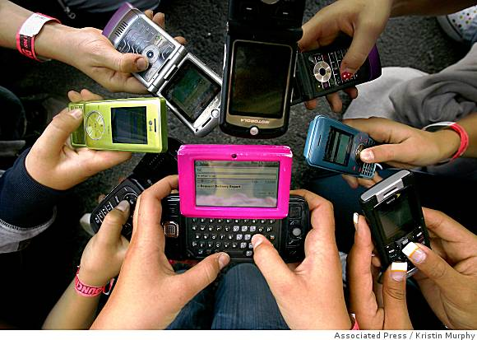
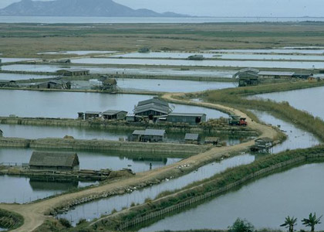
Developed vs. Developing
Developed
Developing
People have access to telephone and are part of global network.
Modern communications are not found outside of city.

Slide 30
THANK YOU

